Slide 1
College of Humanities and Social Sciences
Welcome to Open House
September 22, 2018

Slide 2
Who are we?
We are the largest College on Campus with ~ 6710 students enrolled in our college (as of fall 2017).
We have 11 schools/departments
We have 22 majors
We offer over 50 degrees, minors, and certificates.

Slide 3
CHSS Mission
Prepare students with a Liberal Arts education that empowers them to understand the human condition, to meet the challenges of the twenty-first century, and to become contributing citizens in a global society.

Slide 4
CHSS Features
The fully online B.S. in Sociology degree has been recognized by the SR Education Group as a best value among schools with high academic strength.
The Student Anthropology Club celebrated International Archaeology Day by leading kids and adults in fun and educational archaeological activities at the Roswell Farmers and Artisans Market. Drawing on their experiences in the classroom and in the field, students taught community members about stratigraphy, faunal and skeletal analysis, and ancient technologies including flintknapping, drilling, and clay pot making. International Archaeology Day is a global event held annually on the third Saturday of October to celebrate archaeology and teach communities about the past.
KSU German Studies program was designed in 2016 as a University Center of Excellence by the American Association of Teachers of German.
The online Political Science degree is ranked as 8th best online program nationally.
The online Bachelor degree program in Geography at KSU is ranked as the fourth best in the nation by TheBestSchools.org. They selected the degree programs based on the quality of the program, types of courses provided, and faculty strength, as well as school awards, rankings, and reputation, specifically a strong reputation for quality online degree programs.

Slide 5
CHSS Features
The Philosophy Student Association President, Zach Gruca, was inducted into the 2016 Who's Who Among Students in American Universities and Colleges. Since 1934, the Who’s Who Among Students in American Universities & Colleges organization has been honored outstanding campus leaders annually for their scholastic, co-curricular, leadership and community achievements.
The KSU Model NATO team competed at the International Model NATO Conference in Washington, D.C. Our nine students represented the Czech Republic and won five committee awards and the overall Outstanding Delegation Award. This is a fantastic achievement. Twenty universities from NATO member states sent teams, 12 from the U.S. In addition to KSU, Northeastern University and Converse College won delegation awards.
Students in Careers in Writing class drafted and executed a 32-page media plan for the visit of Novelist Ravi Howard to the Kennesaw campus. The students wrote press releases and contacted a variety of media outlets, wrote social media content, and designed flyers. They also brainstormed interview questions and engaged with Mr. Howard in a lively Q-and-A when he visited their class.

Slide 6
CHSS Features
The Department of Psychological Science hosted the 14th Annual Georgia Undergraduate Research in Psychology conference, which attracted students and faculty from over 20 colleges and universities throughout the U.S.
Sociology majors visited Kia Motor Manufacturing for their Social Organization class. They had extensive discussions with plant managers while working on research projects on the impact of foreign corporations on the state of Georgia. The class was open to the online students as well; a few drove from as far as Augusta to benefit from the experience. Some have tried Japanese and Korean food for the first time while on the Kia trip!
The school of Communication and Media held its sixth annual Communication Colloquium this month (September 2018), with a keynote address focused on the use of immersive technologies, such as virtual and augmented reality, in communication and media industries. Leading professionals lead five breakout sessions for the school’s students majoring in Public Relations, Journalism & Emerging Media, Media and Entertainment, and Organizational and Professional Communication. The school also offers an online graduate certificate program and M.A. in Integrated Global Communication program. The school is home to four student organizations.

Slide 7
CHSS Features
Over 40 students inquiring about Kennesaw State University’s newest declarable major, a Bachelor of Arts in Asian Studies, came to hear a panel of esteemed deans, professors, and employers, share information and answer daunting questions about the budding program. Beyond the required coursework, there are Asian Studies organizations, such as ASSO, that welcome individuals with a research interest in Asia.
The Department of Technical Communication and Interactive Design (TCID) had 4 students participate in the 12 week, fully paid User Experience (UX) internship at Home Depot. The two students received offers of fulltime employment based on their summer performance; they’ll be starting as son as they graduate.
School of Government and International Affairs faculty direct the Model UN, Model NATO, and Mock Trial competition teams.

Slide 8
Student Learning outcomes with a Liberal Arts Degree from the College of Humanities and Social Sciences at KSU.
Creative thinking, problem-solving, decision-making
Critical thinking
Message design: Oral, written, theoretical, applied
Understanding basic social science research design
Understanding basic communication theories
Ethical sensitivity
Diversity, knowledge and appreciation of multiple perspectives

Slide 9
School of Communication and Media
We offer courses that expose students to the art and science of communication and prepare them to achieve fulfilling careers in media, journalism, public relations, entertainment, organizational communication and other communication areas.
B.S. in Journalism and Emerging Media
B.S. in Media and Entertainment
B.S. in Organizational and Professional Communication
B. S. in Public Relations
Minors in both Crisis Preparedness and Public Relations
Certificate in Multiplatform News Reporting

Slide 10
School of Government and International Affairs
Primary goal is to provide our students with the necessary academic and communication skills, knowledge base, and analytical abilities to understand political systems and critical issues, and to be involved citizens and high-performing professionals in their chosen careers.
B.A. in International Affairs
B.S. in Political Science
Minors in International Affairs, Legal Studies, Political Science
Certificates in Alternative Dispute Resolution, Constitutional Studies, European Union Studies, Intelligence and Homeland Security, Political Communication and Professional Politics and Intelligence and Homeland Security.

Slide 11
Department of English
Students pursue career-sensitive degrees connected to writing, language, literature, film, and theory. The Department also encourages students to join a community of learners dedicated to thinking, writing, and reading critically and to making meaningful intellectual contributions to the larger world around them. Anyone interested in teaching English in grades 6 -12 will call the English Department home.
B.S. in English Education
B.A. in English
Minors in Film Studies, Language and Literary Studies, Linguistics, and Professional Writing

Slide 12
Department of Foreign Languages
Offer a single major, the B.A. in Modern Language and Culture, with a primary language of Chinese, French, German, Italian, or Spanish. The B.A. has four concentrations: Second Language and Culture, Foreign Language Education, Applied Business, and Cross Disciplinary Perspectives.
Minors are available in Spanish, French and Francophone Studies, German Studies, Chinese Studies, Italian Studies, and Lusophone Studies. We are currently expanding programs in Japanese, Korean, and Latin. In addition, we offer courses in Arabic, Hebrew, and Russian through the Critical Languages Program.
B.A. in Modern Language and Culture
Minor in Chinese Studies, European Studies, French and Francophone Studies, German Studies, Italian Studies, Lusophone Studies, and Spanish.

Slide 13
Department of Geography and Anthropology
We are a student-centered department committed to fulfilling the mission of the College of Humanities and Social Sciences, which is to prepare students with a liberal arts education that empowers them to understand the human condition, to meet the challenges of the 21st century, and to become contributing citizens in a global society. We do this with excellent classroom teaching, collaborative research between faculty and students, and encouraging study abroad programs.
B.A. in Geography
B.S. in Anthropology
B.S. in Geographic Information Science
Minor in Anthropology, Environmental Studies, Geography, Native-American Studies
Certificate in Geographic Information Science

Slide 14
Department of History and Philosophy
The department is diverse and active professionally. Our highly qualified faculty regularly present their research at regional, national and international meetings. They have published articles in major journals in their areas of specialization as well as a number of important monographs and book chapters. Faculty engagement continues to be a major goal of the department. Our award-winning faculty have received recognition for teaching, scholarship and service.
B.A. in History
B.S. in History Education
B. A. in Philosophy
Minor in History, Philosphy, Slavic, East European, and Eurasian Studies
Certificate in Public History

Slide 15
Department of Interdisciplinary Studies
Interdisciplinary Studies Department is unique, specifically designed with the mission of teaching how multiple disciplines intersect and learning about the synergies that such intersections create. ISD’s award-winning faculty work closely with students in order to prepare them for the challenges of the 21st century, challenges that require real-world understandings of the interconnectedness of people and ideas. Interdisciplinary research is on the cutting edge of problem solving in a number of areas inside and outside of the humanities, including social sciences, sciences, business, and education.
B.A. in African and African Diaspora Studies
B. A. in Asian Studies
Minor in Asian Studies, Comparative American Studies, Gender and Women’s Studies, Latin American and Latina/o Studies, Peace Studies, and Religious Studies
Certificates in Diversity and Community Engagement, Gender and the workplace, Peace Corps Prep Program

Slide 16
Department of Psychological Science
The Department of Psychological Science offers an undergraduate program that provides students with opportunities for personal, professional, and intellectual development. Courses in the psychology program teach students about both the scientific and applied areas of the field. To begin the major, all students complete the introductory course in psychology and a course on careers in psychology. A two-semester research sequence follows, which emphasizes statistics, methodology, and experimental psychology. Students then complete upper-level courses that represent five foundational areas of the field of psychology. Students take electives that align with their unique interests and career goals, thereby developing informal concentrations in such areas as developmental psychology, multicultural psychology, experimental psychology, neuropsychology, or counseling/clinical psychology. Last, the Senior Capstone experience provides closure to a student's undergraduate education. In addition to learning about the mind and behavior, students learn vital skills such as critical thinking skills, communication skills, analytical skills, problem-solving skills, and interpersonal skills, such that upon graduation, students are prepared for a wide range of employment opportunities and/or graduate education in psychology or related fields such as law, medicine, business, management, education, or social work.
B.S. in Psychology
Minor in Psychology

Slide 17
Department of Sociology and Criminal Justice
The Department of Sociology and Criminal Justice prepares students to understand and deal with diversity, justice, modernization, and social change. The core competencies emphasized by this department prepare graduates to enter careers requiring technological facility, communication skills, data gathering and analysis, applied research skills, community awareness and involvement, problem-solving, critical thinking, professional writing, an understanding of the structure and functioning of groups and organizations, critical self-reflection, interpersonal and intercultural skills, and adherence to the highest ethical standards. Besides career preparation, specific concentrations in the majors also provide background for graduate or professional study in each of our two disciplines.
B.S. in Criminal Justice
B.S. in Sociology
Minor in Criminal Justice, Criminology, Gerontology, Sociology and Medical Sociology

Slide 18
Department of Technical Communication and Interactive Design
Our Bachelor of Science in Technical Communication (TCOM) program has remained the only technical communication degree program in the Greater Atlanta area for nearly 24 years. Our focus is on the “tech” in technical communication, and we use humanities-based thinking to inform our work. Our courses introduce students to accessibility issues, information architecture, SEO and analytics, usability/user experience, and research methods.
We also offer the Bachelor of Science in Interactive Design (IAD). As our newest offering, the IAD program addresses the need for emerging competencies in user interface design and development. Using an interdisciplinary, hands-on approach, the IAD degree develops the technical, theoretical, and creative skills needed to meet the demands of new, digitally-centered careers.
Both the TCOM and IAD programs enrich the educational lives of our graduates with internships, cutting-edge coursework, and career-centered practices. Whether you’re coming straight from high school or you’re looking for new opportunities, our programs can take your future in exciting new directions.
B.S. in Interactive Design
B.S. in Technical Communication

Slide 19
Minors/Certificates
Minors
Professional Writing
Psychology
Public Relations
Religious Studies
Slavic, East European, & Eurasian Studies
Sociology
Spanish
Technical Communication
Certificates
Alternative Dispute Resolution
Constitutional Studies
Creative Writing*
Digital and Social Media*
Diversity and Community Engagement
European Union Studies
Gender and the Workplace
Geographic Information Science
Latin American Studies
Multiplatform News Reporting
Political Communication
Professional Politics
Professional Writing for International Audiences*
Public History
Technical Communication
*denotes Graduate certificate
African & African Diaspora Studies
American Studies
Anthropology
Asian Studies
Chinese Studies
Classical Studies
Criminal Justice
Criminology
Crisis Preparedness
Environmental Studies
European Studies
Film Studies
French & Francophone Studies
Gender & Women’s Studies
Geography
German Studies
Gerontology
History
International Affairs
Italian Studies
Language & Literary Studies
Latin American & Latino Studies
Legal Studies
Lusophone Studies
Military Leadership
Native American Studies
Peace Studies
Philosophy
Political Science

Slide 20
Graduate Programs
Ph.D. in International Conflict Management
Ed.D. in Adolescent English Education*
Ed.S. in Adolescent English Education*
Master of Arts in American Studies
Master of Arts in Integrated Global Communication
Master of Arts in Professional Writing
Master of Arts in Teaching English*
Master of Arts in Teaching in Foreign Languages*
Master of Education in Adolescent English Education*
Master of Public Administration
Master of Science in Conflict Management
Master of Science in Criminal Justice
Master of Science in International Policy Management

Slide 21
Student Resources
CHSS Advising Center
Located in two places on campus 1) Willingham Hall Suite 223 and 2) Math and Stats Building. Advisors assist students from the point of interest to becoming a KSU student and beyond graduation. Advisors are the students’ advocate.
CHSS Undergraduate Research Atrium
Located on the first floor of the Social Sciences building, this area is dedicated to foster and support undergraduate research projects created by Kennesaw State University students.
Computer Labs
The College of Humanities and Social Sciences houses 3 computer labs available to all KSU students.
Foreign Language Resource Collection
The Foreign Language Resource Collection exposes students to a more vivid language experience by listening to different voices and accents and to foster interpersonal exchange in order to assist students in acquiring and improving their foreign language skills.
Digital Production Lab
The digital production labs offered through the school of Communication and Media provide cutting-edge digital production space for students to collaborate on video, audio and web content and multimedia formats for storytelling.
The Usability Lab
Situated on the Marietta Campus, provides students with a testing facility for conducting participant based research and User Experience (UX) studies.

Slide 22
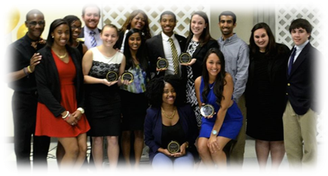
Student Organizations
Pi Sigma Alpha (Honor Society)
KSU High School Model UN
The Global Society
The Political Science Club
Kennesaw Communication Association
Lambda Pi Eta (Communication Honor Society)
KSU Public Relations Student Society of America (KSU PRSSA)
KSU Society of Professional Journalists
Graduate Writers Association
National Council of Teachers of English Student Affiliate.
Sigma Tau Delta
Pi Delta Phi (French Honor Society)
Sigma Delta Pi (Spanish Honor Society)
Chinese Club
French Club
German Club
Italian Club
Japanese Club
Korean Language Club
Spanish Club
Lambda Alpha (Anthropology Honor Society)
Gamma Theta Upsilon (Geography Honor Society)
Student Anthropology Club
Student Geography Club
Phi Alpha Theta (History Honor Society)
Philosophy Student Association
PRSSA (Public Relations Society of America)
Southeast World History Association
AMSTO (American Studies Student Organization)
AADS Student Organization
KSU Psychology Club
Psi Chi National Honor Society in Psychology
Alpha Kappa Delta (Sociology Honor Society)
Alpha Phi Sigma (Criminal Justice Honor Society)
Student Organization of Sociology
Criminal Justice Student Organization

Slide 23
Internships
Georgia State Capital
Cobb County Jail
Dekalb County Police Department
Department of Natural Resources - Law Enforcement
FBI
Ga Department of Public Safety
United States Marshal Service
Department of Defense
Atlanta Police Department
11Alive
Kennesaw Mountain National Battlefield Park
Gingrey for Senate
Council for Quality Growth
Scot Turner for State House Campaign
American Lung Association in Georgia
Starbucks
Wal-Mart
Home Depot
Washington Seminar Internship
Georgia Legislative Internship
And many more!!
Antonio J. Waring Jr. Archaeology Lab
Fernbank Museum of Natural History
Georgia Historic Preservation Division
U.S. Museum of Anthropology, University of Pennsylvania
CDC
Library of Congress
Smithsonian Museum
Georgia Bureau of Investigation
Atlanta Falcons
Atlanta Film Festival
Atlanta Magazine
CNN
Georgia House of Representatives
Girl Talk
Hot 107.9 Radio One ATL
Kicks 101.5
Underground Atlanta
Six Flags Over Georgia

Slide 24
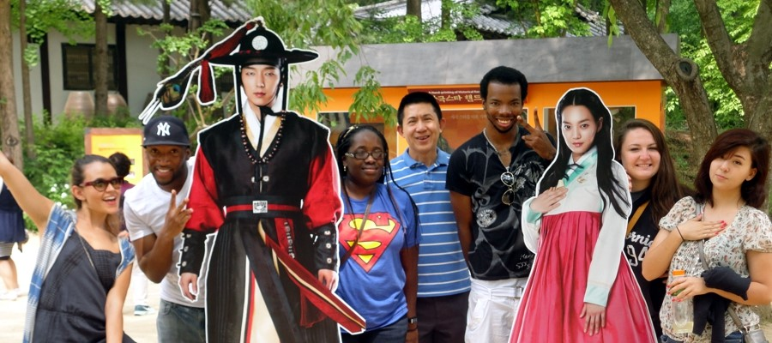
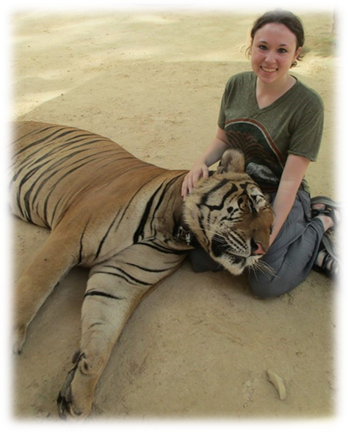
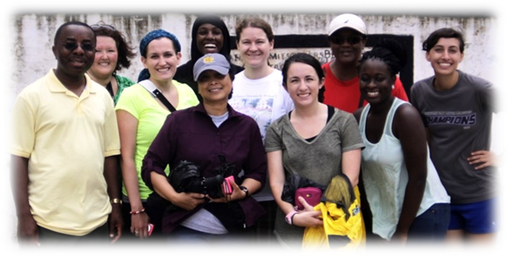
Study Abroad
France
Germany
Ghana
Greece
Guinea Bissau
Hong Kong
Hungary
Iceland
Argentina
Australia
Austria
Belgium
Belize
Brazil
Canada
Martinique
Mexico
Morocco
Netherlands
New Zealand
Nicaragua
Norway
India
Indonesia
Italy
Japan
Latvia
Malaysia
Malta
Peru
Poland
Puerto Rico
Russia
South Africa
South Korea
Spain
Chile
China
Colombia
Costa Rica
Denmark
Fiji
Finland
Sweden
Switzerland
Taiwan
Thailand
Turkey
UK
Uruguay

Slide 25
Careers
Field Archaeologist Patient/Client Advocate
Museum Curator Career or Vocational Counselor
Public Information Officer School Psychologist (M.S. or Ph.D)
Sales Representative Counselor (M.S. or Ph.D)
Advertising Specialist
Account Executive Manager
Broadcasting Station Manager
Announcer
Corporate Public Affairs
Campaign Director
CIA Agent
Deputy Marshall
Police Detective
Secret Service Agent
Environmental Conservation Officer
Librarian
Speechwriter
Lobbyist
Personnel Manager
Public Relations Staffer
Researcher
Mental Health technician
Case Manager
User Experience Researcher
Technical Trainer
Social Studies Teacher
Business Manager
Public Historian
Manager Non-Governmental Organization
Minister
Archivist
Diplomatic Services
Government Services
IT Support
Technical Communicator
Interactive Designer
Etc.
Excellent Preparation for Graduate Study in:
Law
Medicine
Area Studies
History
Philosophy
Public Health
Etc.

Slide 26
Top Companies that Recruit KSU Students
MailChimp
WellStar Health System
KPMG, LLP
AT&T
ThyssenKrupp
US Dept. of Justice (DOJ)
Federal Bureau of Investigation (FBI)
Public Broadcasting Atlanta
Norfolk Southern
Kaiser Permanente
Radio Disney
Center for Disease Control
Georgia Aquarium
Enterprise
Atlanta Hawks
Coca-Cola
The Carter Center
CNN
The Hershey Company
Philips Arena
Atlanta Braves
Atlanta Falcons
Hewlett Packard
The Home Depot
Turner Broadcasting
The Shepherd Center
UPS
Children's Healthcare of Atlanta
Fresenius Medical Care
The Weather Channel

Slide 27
Contact
College of Humanities & Social Sciences
Social Sciences Building #22
Phone: 470-578-6124
www.chss.kennesaw.edu
HSS Undergraduate Advising
Willingham Hall 223
Phone: 470-578-7728
chssadvising@kennesaw.edu
Look at your program schedule to see what is next on your agenda for the day…

