Slide 1
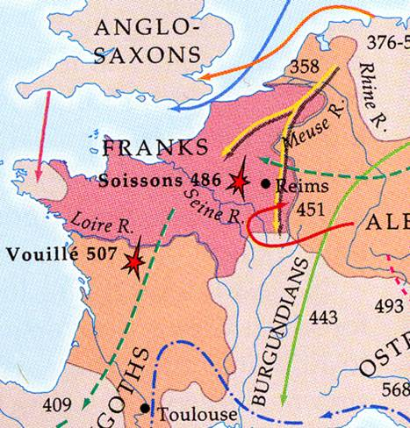
Origins of Feudalism
Heartland
Comitatus
Ingenui in Obsequio
Gwas=Vassals
Beneficium = Fiefs

